Slide 1
EMPLOYEE ATTRITION ANALYSIS

Slide 2
INTRODUCTION
This visualization project aims to analyze the Attrition rate of employees and what other factors affect the organization's overall rate.
This meticulously crafted dashboard aims to revolutionize organizational strategies by providing a comprehensive, data-driven approach to enhance employee performance and fortify retention rates within our company. By amalgamating multifaceted metrics encompassing performance indicators, engagement levels, attrition rates, and employee satisfaction, this dashboard aims to serve as an invaluable tool for decision-makers. It intends to offer real-time insights, enabling swift, proactive interventions to boost employee morale, identify areas for improvement, and implement targeted initiatives that foster a culture of growth, support, and empowerment.
Tool use: Excel and Power Bi

Slide 3
The three key steps involved in this project include:
1.Data Collection
2.Data Cleaning
3.Implementing Key Performance Indicators (KPIs) for Data Analysis in Power BI
Date collection : Dataset given in project.
Date cleaning : The Data Cleaning involved tasks like handling missing values, removing duplicates, correcting data types, and addressing inconsistency in any column where duplicate categories were not aiding in giving proper analysis.
Implementing Key Performance Indicators (KPIs) : This step was carried out in Microsoft Excel where the pivot table helped in understanding crucial metrics to help organizations towards specific goals or objectives.

Slide 4

MAIN KPIs
Count of employee
Attrition
Attrition rate
Average age
Average salary
Average years at company

Slide 5
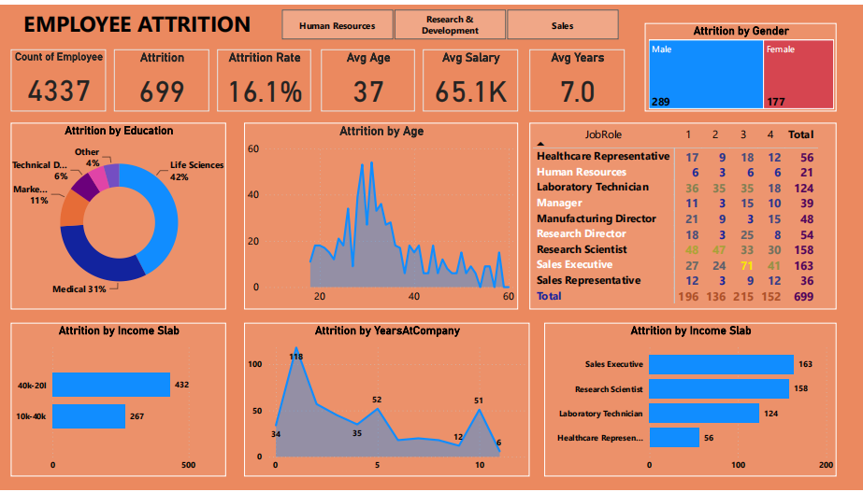
FINAL DASHBORD

Slide 6
THANK YOU

